Slide 1
Chapter 4:
Fault Tolerant Hamiltonian Graphs

Slide 2
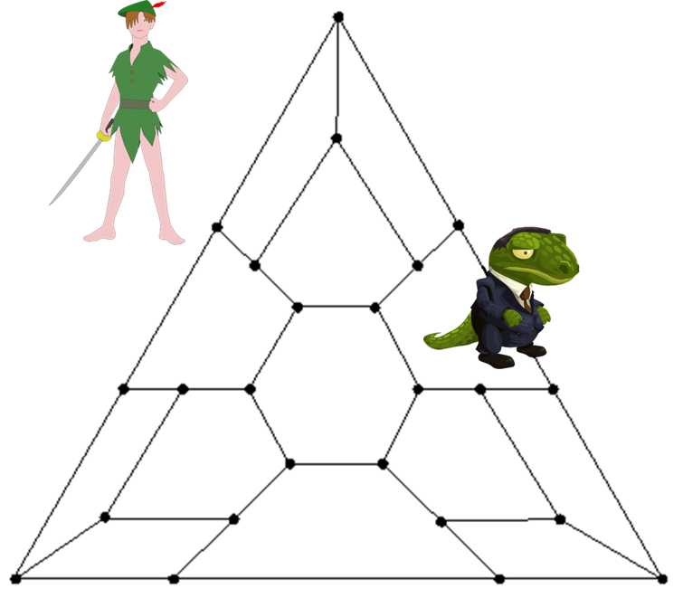

Slide 3
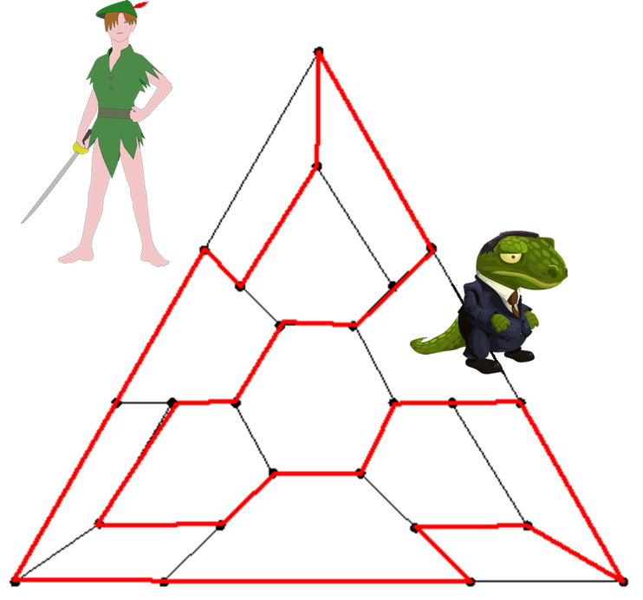

Slide 4
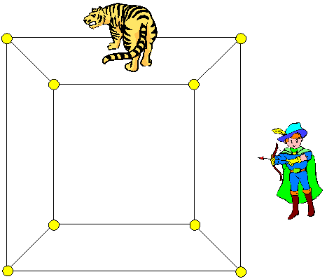

Slide 5
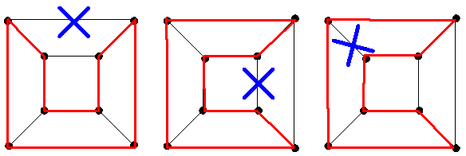

Slide 6
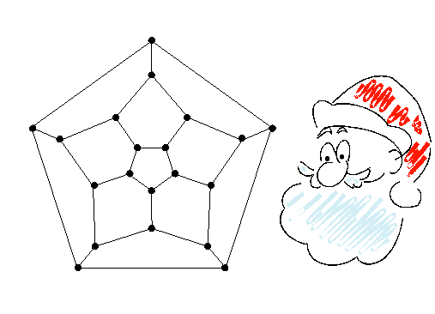

Slide 7
1-edge fault tolerant Hamiltonian graphs:
Categories 1 and 2.

Slide 8



Slide 12
1-vertex fault tolerant Hamiltonian graphs: Category 1.
1-fault tolerant Hamiltonian graphs

Slide 13
Construction of a 1-edge fault tolerant Hamiltonian graph and/or a 1-vertex fault tolerant Hamiltonian graph with 100 vertices.
K₁₀₀.
Cost: number of edges
Optimal result?

Slide 17
A construction scheme: 3-join

Slide 25
“K is 1-edge fault tolerant Hamiltonian if and only if both G and H are 1-edge fault tolerant Hamiltonian.”

Slide 29
Thus, we can conclude that “K is 1-fault tolerant Hamiltonian if both G and H are 1-fault tolerant Hamiltonian.”
However, we cannot conclude that “K is 1-vertex fault tolerant Hamiltonian if both G and H are 1-vertex fault tolerant Hamiltonian.”

Slide 30
Special example:

Slide 32
Another comparison:
Harary, F. and Hayes, J.P., Edge fault tolerance in graphs, Networks, 23, 135, 1993.
Harary, F. and Hayes, J.P., Node fault tolerance in graphs, Networks, 27, 19, 1996.

Slide 33
With these figures, you can construct MS₄,MS₅, MS₆,… and so on. Let us compare H₁₃ with MS₄, as shown in Figure 4-30.
Mukhopadhyaya, K. and Sinha, B.P., Hamiltonian graphs with minimum number of edges for fault-tolerant topologies, Information Processing Letters, 44, 95, 1992.

Slide 34
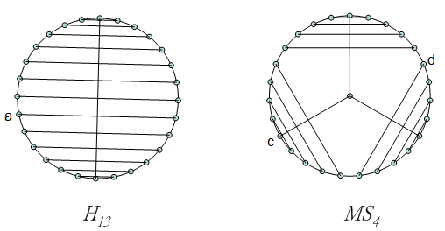
b

Slide 35
These two graphs have 28 vertices and 42 edges.
The diameter of MS₄ is 8 and the diameter of MS₄ is 6.

Slide 36
H₄₉₉₉ is a graph with 10000 vertices and a diameter of 2502.
n/4
MS₁₆₆₆ is a graph with 10000 vertices and a diameter of 1667.
n/6

Slide 37
W₄₉ is a graph with 9900 vertices and a diameter of 150 while W₅₀ is a graph with 10302 vertices and a diameter of 153.
1.5n ^{1/2}

Slide 41
. It can be shown that B₁₂ is a graph with 12286 vertices and a diameter of 24.
2 log n

Slide 42
Another comparison

Slide 43
We have seen that all graphs in Category 1 are Hamiltonian connected, 1-edge fault tolerant Hamiltonian, and 1-vertex fault tolerant Hamiltonian. Thus, there are many graphs in region 1.

Slide 44
The graph in Figure 4-36 is in region 2: cubic Hamiltonian graphs, 1-edge fault tolerant Hamiltonian, not 1-vertex fault tolerant Hamiltonian nor Hamiltonian connected.
Figure 4-36

Slide 45
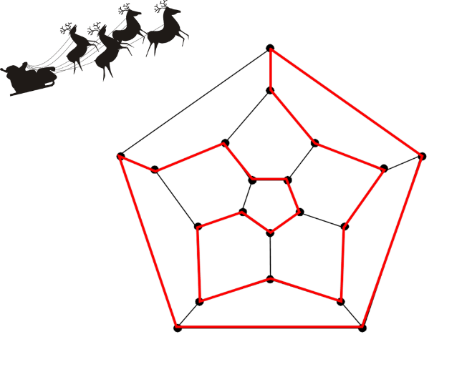
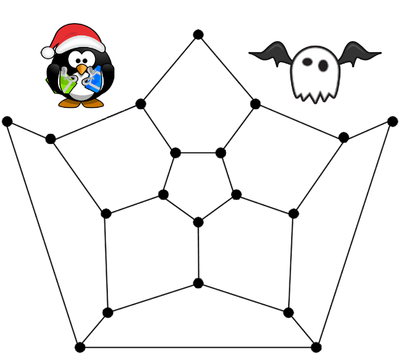

Not 1-vertex fault tolerant Hamiltonian
Figure 2-2
1-edge fault tolerant Hamiltonian
Hamilton
Not Hamiltonian connected

Slide 46
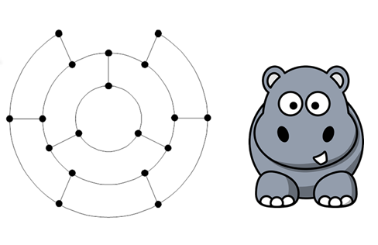


The graph in Figure 4-37 is in region 3: cubic Hamiltonian graphs, not 1-edge fault tolerant Hamiltonian, but 1-vertex fault Hamiltonian and Hamiltonian connected.
Hamiltonian connected:
Brute force
Not 1-edge fault tolerant Hamiltonian
1-vertex fault tolerant Hamiltonian

Slide 47
The graph in Figure 4-38 is in region 4: cubic Hamiltonian graphs, 1-edge fault tolerant Hamiltonian and Hamiltonian connected, but not 1-vertex fault Hamiltonian.
Figure 4-38
1-edge fault tolerant hamiltonian
Not 1-vertex fault tolerant Hamiltonian
Hamiltonian connected: brute force

Slide 48
The graph in Figure 4-39 is in region 5: cubic Hamiltonian graphs, 1-edge fault tolerant Hamiltonian and 1-vertex fault Hamiltonian, but not Hamiltonian connected.
Figure 4-39

Slide 49
Note that the graph in Figure 4-39 can be obtained from the graph in Figure 4-40 by a sequence of vertex expansions. With brute force, we can check the graph is 1-fault tolerant Hamiltonian. (With symmetric property)
1-edge fault tolerant Hamiltonian.
1-vertex fault tolerant Hamiltonian

Slide 50
Not Hamiltonian connected: Grinberg condition and shinking
Figure 4-41

Slide 51
There are two possibilities: (x,z) is on the Hamiltonian cycle or not.
Suppose that (x,z) is on the cycle.
Figure 4-42

Slide 52
Suppose, conversely, that (x,z) is not on the cycle.

Slide 53
The graph in Figure 4-44 is in region 6: cubic Hamiltonian graphs, 1-vertex fault tolerant Hamiltonian but not 1-edge fault Hamiltonian nor Hamiltonian connected.
Figure 4-44

Slide 54
3-join
Figure 4-45

Slide 55
Thus, K is Hamiltonian.
K is 1-vertex fault tolerant Hamiltonian.

Slide 56
, K is not 1-edge fault tolerant Hamiltonian.
There is no Hamiltonian path of G between c and d. Thus, K is not Hamiltonian connected.

Slide 57
The graph in Figure 4-46 is in region 7: cubic Hamiltonian graphs, Hamiltonian connected but not 1-edge fault tolerant Hamiltonian nor 1-vertex fault Hamiltonian.

Slide 58
3-join

Slide 59
We have already noticed that the graph H is Hamiltonian. Since the vertex x in G is carefully selected, there exists a fault-free Hamiltonian cycle of G if any (x,x_{i}) is faulty for i=1,2,3. Thus, we can extend the Hamiltonian cycle of H into a Hamiltonian cycle of K. Thus, K is Hamiltonian.
Suppose that K is 1-edge fault tolerant Hamiltonian. Then there exists a fault-free Hamiltonian cycle if the edge (a,b) is faulty. Obviously, this cycle uses (x₁,y₁), (x₂,y₂), or (x₃,y₃). Without loss of generality, let us assume that (x₂,y₂) is not in the cycle. Then this cycle can be described as beginning with x₁, followed by a path P to x₃, then y₃, followed by a path Q to y₁, then back to x₁. The path begins with y, then y₃, followed by the path P to y₁, then back to y, forming a fault-free Hamiltonian cycle of H. However, we already know that there is no fault-free Hamiltonian cycle of H if the edge (a,b) is faulty. Thus, K is not 1-edge fault tolerant Hamiltonian.

Slide 60
Suppose that K is 1-vertex fault tolerant Hamiltonian. Then there exists a fault-free Hamiltonian cycle if the vertex c is faulty. Obviously, this cycle uses (x₁,y₁), (x₂,y₂), or (x₃,y₃). Without loss of generality, let us assume that (x₂,y₂) is not in the cycle. Then this cycle can be described as beginning with x₁, followed by a path P to x₃, then y₃, followed by a path Q to y₁, then back to x₁. The path begins with x, then x₁, followed by the path P to x₃, then back to x, forming a fault-free Hamiltonian cycle of G. However, we already know that there is no fault-free Hamiltonian cycle of G if the vertex a is faulty. Thus, K is not 1-vertex fault tolerant Hamiltonian.
By trial and error, we can check that the graph K is Hamiltonian connected. Thus, the graph K is in region 7.

Slide 61
The graph in Figure 4-48 is in region 8: cubic Hamiltonian graphs but not Hamiltonian connected, not 1-edge fault tolerant Hamiltonian, and not 1-vertex fault Hamiltonian.

Slide 62
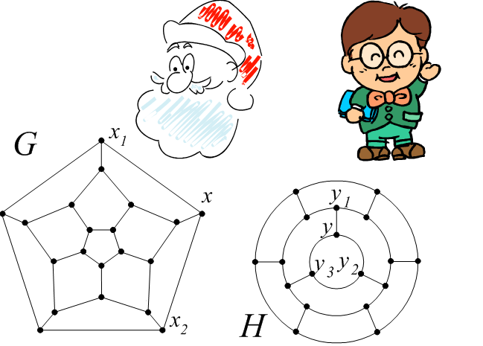
3-join
x₃

Slide 63
We have already noticed that graph H is Hamiltonian. Note that graph G is 1-edge fault tolerant Hamiltonian. There exists a fault-free Hamiltonian cycle of G if any (x,x_{i}) is faulty for i=1,2,3. Thus, we can extend the Hamiltonian cycle of H into a Hamiltonian cycle of K. Thus, K is Hamiltonian.
Suppose that K is 1-edge fault tolerant Hamiltonian. If so, there exists a fault-free Hamiltonian cycle if the edge (a,b) is faulty. This cycle uses (x₁,y₁), (x₂,y₂), or (x₃,y₃). Without loss of generality, let us assume that (x₂,y₂) is not in the cycle. Then this cycle can be described as beginning with x₁, followed by a path P to x₃, then y₃, followed by a path Q to y₁, then back to x₁. The path begins with y, then y₃, followed by the path P to y₁, then back to y, forming a fault-free Hamiltonian cycle of H. However, we already know that there is no fault-free Hamiltonian cycle of H if the edge (a,b) is faulty. Thus, K is not 1-edge fault tolerant Hamiltonian.

Slide 64
Suppose that K is 1-vertex fault tolerant Hamiltonian. If so, there exists a fault-free Hamiltonian cycle if the vertex c is faulty. This cycle uses (x₁,y₁), (x₂,y₂), or (x₃,y₃). Without loss of generality, let us assume that (x₂,y₂) is not in the cycle. Then this cycle can be described as beginning with x₁, followed by a path P to x₃, then y₃, followed by a path Q to y₁, then back to x₁. The path begins with x, followed by the path P to x₃, then back to x, forming a fault-free Hamiltonian cycle of G. However, we already know that there is no fault-free Hamiltonian cycle of G if the vertex c is faulty. Thus, K is not 1-vertex fault tolerant Hamiltonian.

Slide 65
Suppose that K is Hamiltonian connected. If so, there exists a Hamiltonian path in K between c and d. This path uses (x₁,y₁), (x₂,y₂), or (x₃,y₃). Without loss of generality, let us assume that (x₂,y₂) is not in the cycle.
Without loss of generality, let us assume that (x₂,y₂) is not in the path and this path can be described as beginning with c, followed by a path P to x₁, then y₁, followed by a path Q to y₃, x_{3.} then followed by a path R to d. The path begins with c, followed by the path P to x₁, x, x_{3,} then followed by a path R to d, forming a Hamiltonian path of G. However, we already know that there is no Hamiltonian path of G between c and d. Thus, K is not Hamiltonian connected. Thus, the graph K is in region 8.

Slide 66
Suggested Reading and Possible Future Directions
We have seen that a computer network can be represented by graphs in which the vertices are computers and the edges represent the links between computers. Moreover, the Hamiltonian cycle is used as a token ring to control the network. Yet, the Hamiltonian cycle cannot exist if some edges or vertices are faulty. To prevent the occurrence of faulty edges, in 1993, Harary and Hayes suggested building a network such that it remain Hamiltonian even when some edges become faulty [2]. In particular, the family of graphs H_{n} were proposed as optimal 1-edge fault tolerant Hamiltonian graphs.

Slide 67
Later in 1996, Harary and Hayes suggested building a network such that it remain Hamiltonian subject to some vertices becoming faulty [3]. Again, the family of graphs H_{k} was proposed as optimal 1-vertex fault tolerant Hamiltonian graphs. Thus, the family of graphs H_{k} was proposed as optimal 1 fault tolerant Hamiltonian graphs. Harary and Hayes hypothesized that H_{k} is the only cubic optimal 1-vertex Hamiltonian graph with 2(k+1) vertices. Moreover, they suggested re-classifying the family of optimal 1 Hamiltonian graphs if their conjecture is not true.

Slide 68
Wang, Hung, and Hsu [12] observed that the conjecture is not true by finding an earlier result of Mukhopadhyaya and Sinha [10] proposing the family of graphs, MS_{k}. By noting the diameter of H_{k} is around 4/n and the diameter of MS_{k} is around n/6, where n is the number of vertices, Wang, Hung, and Hsu proposed the family of cubic 1- fault tolerant Hamiltonian graphs, W_{k}, of diameter around 1.5n^{1/2} where n is the number of vertices. This spurred the search for finding cubic 1-fault tolerant Hamiltonian graphs with smaller diameters.

Slide 70
Wang, T.Y. Sung, and L.H. Hsu [14] proposed a family of cubic 1-fault tolerant Hamiltonian graphs of diameter around 4 log n, where n is the number of vertices. Later, Hung, Hsu, and Sung [7] proposed a family of cubic 1-fault tolerant Hamiltonian graphs, B_{k}, with a diameter around 2 log n, where n is the number of vertices. This is the best result as of the time of publication. We believe that there are cubic 1-fault tolerant Hamiltonian graphs with diameters much smaller that 2 log n. Note that the family of dense trivalent graphs DT_{k} introduced in the suggested reading and possible future directions of Chapter 2 has a diameter of 1.5 log n, where n is the number of vertices. Yet, DT_{k} is not 1 fault tolerant Hamiltonian for k>2.

Slide 71
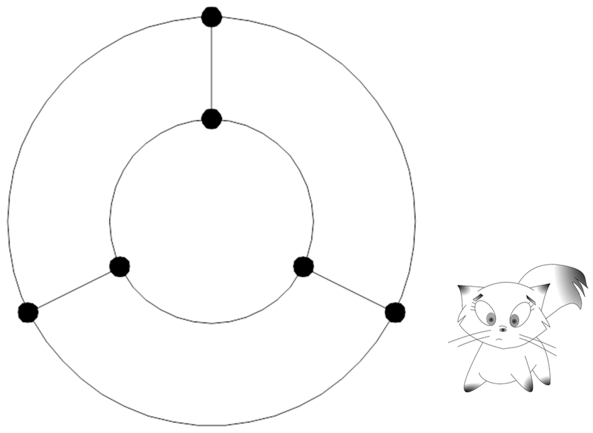
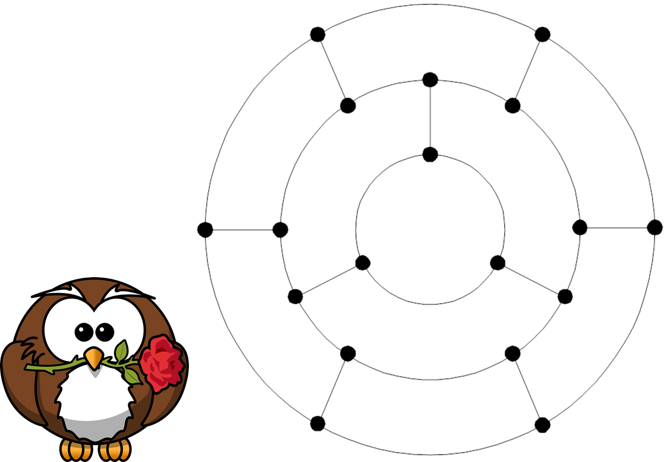
Eye(1)
Eye(2)

Slide 72
Eye(3)
Eye(n) with n is not 2
For some reason, I like this family
Eye(4)

Slide 73
Earth family

Slide 75
The classification of all cubic 1-fault tolerant Hamiltonian graphs is very difficult. So instead, we can examine the construction scheme for such graphs. For example, the 3-join operation is presented by Wang et al. [13]. Additionally, Wang et al. [13] also proposed another construction scheme, called cycle extension. Later, we will discuss other construction schemes.
Cycle extension

Slide 77
Mathematicians are also interested in the comparison of properties among graphs. For this reason, Kao, Hsu, and Hsu [8] investigated the differences between cubic 1-edge Hamiltonian graphs, cubic 1-vertex fault tolerant Hamiltonian graphs, and cubic Hamiltonian connected graphs, proving that there are an infinite number of graphs in each of the possible regions.

Slide 78
We can also study the classification of fault tolerant Hamiltonicity of certain families of cubic graphs. For example, it has been proven [1] that the generalized Petersen graph P(n,1) is 1-fault tolerant Hamiltonian if and only if n≥3 and n is odd, the generalized Petersen graph P(n,2) is 1-fault tolerant Hamiltonian if and only if n=1,3 mod 6 and n≥7. It has also been proven [9] that the generalized Petersen graph P(n,3) is 1-fault tolerant Hamiltonian if and only if n is odd and n ≥7 and the generalized Petersen graph P(n,4) is 1-fault tolerant Hamiltonian if and only if n is odd and n ≠12 with n≥9.
P(17,3)

Slide 79
It has also been proven [6] that cube connected cycles of order n is 1-fault tolerant Hamiltonian if and only if n is odd and n ≥3. Other examples can be found elsewhere [11].

Slide 80
CCC(3)
CCC(4)
CCC(n) is Cayley

Slide 81
Lovasz’s type open problem
Almost every nonbipartite vertex transitive cubic graph is 1-vertex fault tolerant Hamiltonian.
I have a bipartite version.

Slide 82
Honeycomb Disk
Honeycomb disk

Slide 83
Note that there is another important family of graphs called hypohamiltonian graphs. Any graph in this family of graphs is not Hamiltonian but, in the graph obtained by deletion, any vertex is Hamiltonian. For example, the Petersen graph is the smallest of hypohamiltonian graphs. Readers can refer to the references for more for more hypohamiltonian graphs [4].
So, Peterson graph is not Hamiltonian. However, the deletion of any vertex is Hamiltonian.

Slide 84
References:
M. Albert, R.E.L. Aldread, D. Holton, J. Sheehan, On 3*-connected graphs, Aust. J. Combin. 24 (2001) 193–207.
Harary, F. and Hayes, J.P., Edge fault tolerance in graphs, Networks, 23, 135, 1993.
Harary, F. and Hayes, J.P., Node fault tolerance in graphs, Networks, 27, 19, 1996.
Holton, D. A. and Sheehan J., The Petersen Graph, Australian Mathematical Society Lecture Series, 1993.
Hsu, L.H. and Lin, C.K., Graph Theory and Interconnection Networks, CRC Press, 2008.
Hsu L.H. , Ho T.Y. , Ho Y.H. , Tsay C.W. (2014), “Cycles in cube-connected cycles graphs”, Discrete Applied Mathematics, Vol. 167, 163–171.
Hung, C.N., Hsu, L.H., and Sung, T.Y., Christmas tree: A versatile 1-fault-tolerant design for token rings, Information Processing Letters, 72, 55, 1999.

Slide 85
Kao, S.S., Hsu, K.M., and Hsu, L.H., Cubic planar hamiltonian graphs of various types," Discrete Mathematics, 306, 1364, 2006.
Mai T.C. , Wang J.J., and Hsu L.H., (2008), "Hyper-Hamiltonian generalized Petersen graphs," Computers & Mathematics with Applications , Vol. 55 pp. 2076-2085.
Mukhopadhyaya, K. and Sinha, B.P., Hamiltonian graphs with minimum number of edges for fault-tolerant topologies, Information Processing Letters, 44, 95, 1992.
Teng, Y.H., Tan J.M., and Hsu L.H. (2005), "Honeycomb Rectangular Disks," Parallel Computing, Vol. 31, pp. 371-388.
Wang J.J., Hung C.N., and Hsu L.H., Optimal 1-Hamiltonian graphs, Information Processing Letters, 65, 157, 1998.
Wang J.J., Hung C.N., Tan J.M., Hsu L.H., and Sung T.Y., Construction schemes for fault-tolerant Hamiltonian graphs, Networks, 35, 233, 2000.
Wang J.J, Sung T.Y., and Hsu L.H. (2001), "A Family of Optimal 1-Hamiltonian Graphs with Diameter O(logn)," Journal of Information Science and Engineering , Vol. 17, pp.535-548.

Slide 86
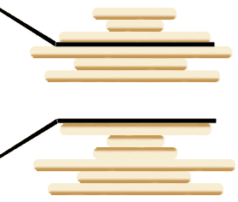
Gates, W.; Papadimitriou, C. (1979). "Bounds for Sorting by Prefix Reversal" . Discrete Mathematics. 27: 47–57.

Slide 87
Pancake graph P₄

Slide 88
Gates problem: Diameter of pancake graph

Slide 89
P_{n} is a graph with n! vertices, (n-1) regular.
(n-3) fault tolerant Hamiltonian
(n-4) fault tolerant Hamiltonian corrected
Prove by induction on both condition

Slide 90
How about other graphs
Cayley graphs
Vertex transitive graphs
Lovasz type open problem
Remark: even shorter diameter (variation pancake graph)

